Slide 1

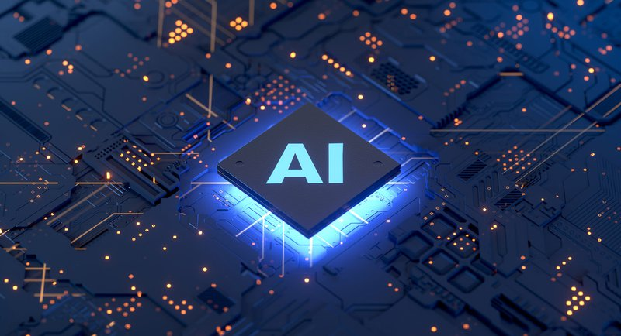
GAUTAM BUDDHA UNIVERSITY, GREATER NOIDA, UP TOPIC: texas (VOICE ASSISTANT) USING PYTHON AND AI
PRESENTED BY :-
LAKSHAY CHAUHAN --- 20/BCA/007

Slide 2
OUTLINE
What is Voice Assistant?
Literature review
Objective
Technology behind voice assistant
Methadology
Modules used in TEXAS
Benefits Of Voice Assistants
Popular Voice Assistants
Conclusion
References

Slide 3
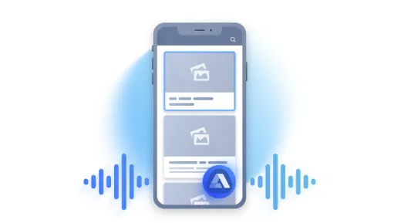
What is Voice Assistant?
A voice assistant is a digital assistant that uses voice recognition, language processing algorithms, and voice synthesis to listen to specific voice commands and return relevant information or perform specific functions as requested by the user.
Based on specific commands, sometimes called intents, spoken by the user, voice assistants can return relevant information by listening for specific keywords and filtering out the ambient noise.
Today, voice assistants are integrated into many of the devices we use on a daily basis, such as cell phones, computers, and smart speakers.

Slide 4
LITERATURE REVIEW
This system has some basic features and most importantly mailing and secondly calendar, where user has the privilege to mail and able to create their required event by providing voice commands. For instance, if we use artificial intelligence we can are able to turn off the lights without the instruction given by the user. Almost, Everyone has some knowledge about trending voice assistant like cortana for windows, and Siri for apple users, this virtual voice assistants aren’t as brainy and intelligent as Ironman's Jarvis which appear in the superhero movie, but the intended actions are almost similar by virtual voice assistant. It’s like you need a ask question, and within a few fraction of seconds you will get an answer. It’s just give a command and get result.

Slide 5
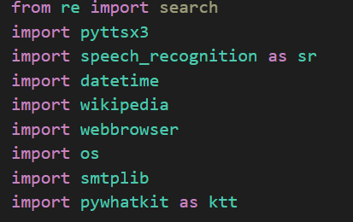
Modules used in texas

Slide 6

Opening of texas

Slide 7

Searching..

Slide 8

Shopping..

Slide 9
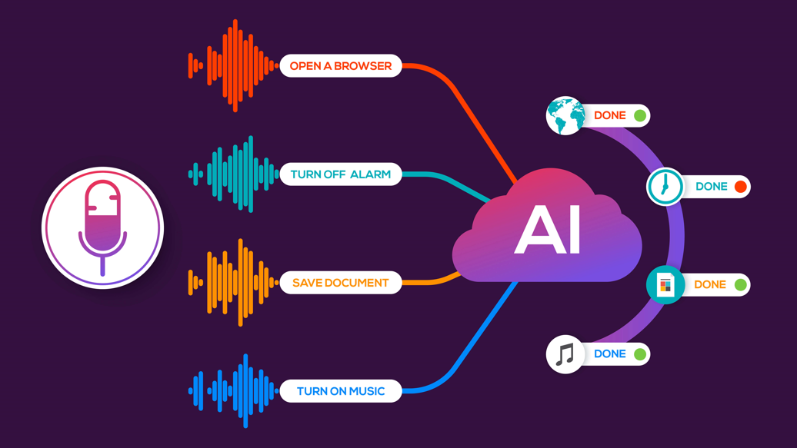
Objectives
Tell The Time
Open Wikepedia
Check Internet Speed Right Now
Open Google Map
Open Social Media Websites
Email Generate Using Voice
Tourism (search hotels and places)
Open Youtube (search and play anything)
Open Google and search anything
Shopping (Search product for user)
Latest news(using Voice)

Slide 10
Technology Behind Voice Assistant
Voice Recognition
Machine Learning
Artificial Intelligence

Slide 11
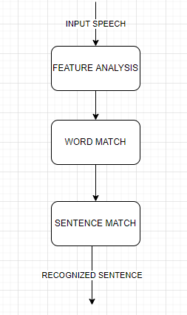
METHODOLOGY

Slide 12
Benefits Of Voice Assistants
1) Minimal Effort
It’s easier to say a few words than type them on a small smartphone screen.
2) Eyes Free
Are you wearing glasses or lenses? Me too. You can be as blind as a bat, but a voice assistant will always help you. Your ears are enough. You can also ask the bot about something while cooking at the same time.
3) Hands-free
The communication with a voice assistant can take place even when your hands are occupied. the voice assistant will be happy to hear what you have to say.
4) Minimally Disruptive
Have you ever wondered how many times you turn on and off your mobile while texting via Messenger? If your smartphone is not muted, you hear a notification sound each time. That’s it. Comfortably read your book and check what is happening in the world using your voice only.
5) Fast response
Imagine how much time you have to spend to find some information on a website? Or how many clicks do you need to make before you find the thing you need in a mobile application? Voice assistants don’t generate such difficulties. You ask a question and you have the answer.

Slide 13
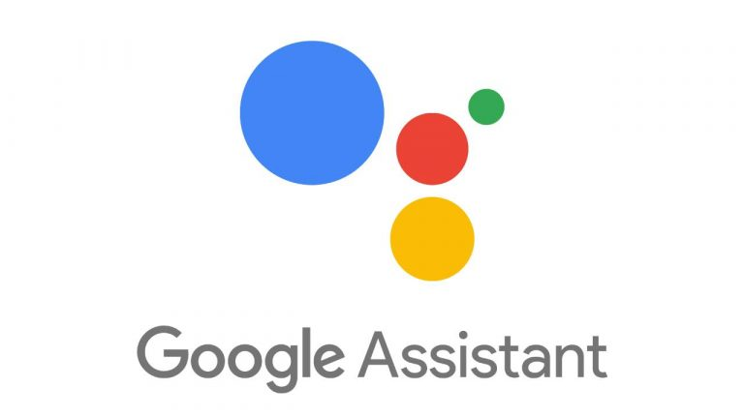



Popular Voice Assistants

Slide 14
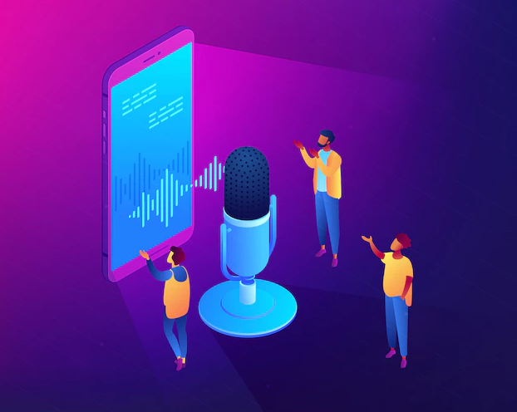
Conclusion
Voice-Controlled Devices uses Natural Language Processing to process the language spoken by the human and understand the query and process the query and respond to the human with the result. The understanding of the device means Artificial Intelligence needs to be integrated with the device so that the device can work in a smart way and can also control IoT applications and devices and can also respond to query which will search the web for results and process it.

Slide 15
References
“Accurate and compact large vocabulary speech recognition on mobile devices,” in INTERSPEECH.2013, pp.662–665, ISCA
Arriany A. A., Musbah M. S. Applying voice recognition technology for smart home networks //Engineering & MIS(ICEMIS), International Conference on. – IEEE, 2016. –С. 1-6.
https://alan.app/blog/voiceassistant-2/

Slide 16


